Slide 1
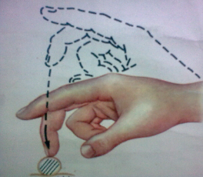
Main clinical syndromes of Urinary system diseases:
- urinary
- nephritic
- nephrotic
- chronic renal failure.

Slide 2
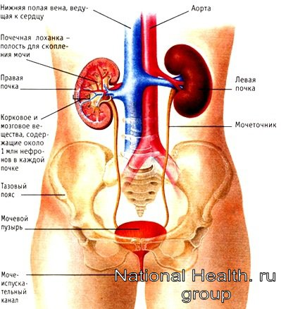
Urinary system

Slide 3
Urinary syndrome
- appearance in urine of protein, erythrocytes, leukocytes and cylinders
Urinary syndrome at acute glomerulonephritis
Changes in urine Mechanisms/reasons
Proteinuria Increase in permeability of capillaries for protein substances (albumin)
Hematuria Inflammation of renal arterioles increases a permeability of a capillary wall for erythrocytes
Leukocyturia Is caused by an immune inflammation of glomerulli and kidneys interstitia
Cylindruria Excretion with urine of protein bodies or cell- like formations of canaliculus origin. Testifies to dystrophic changes in a canaliculus

Slide 4
Changes in urine deposit in urinary syndrome
Urinary syndrome
Changes in urine | Urine test | Nechiporenko ‘s test
 |  | norm (in 1 ml) | Glomerulonephritis | Pyelonephritis | Urolithiasis
Proteinuria 0 - ↑↑ ↑ ↑
Hematuria 0-1 1000 ↑↑↑ ↑ ↑↑↑
Leukocyturia 1-2 2000 ↑ ↑↑↑ 0
Cylindruria 0 20 ↑↑ 0 0

Slide 5
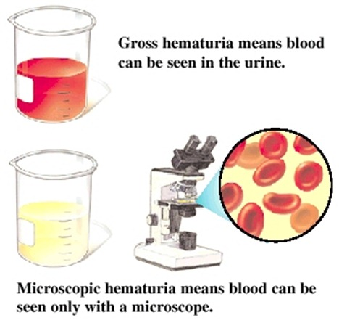
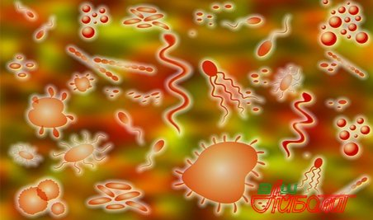
Microscopy of urine deposit in urinary syndrome
Urinary syndrome

Slide 6
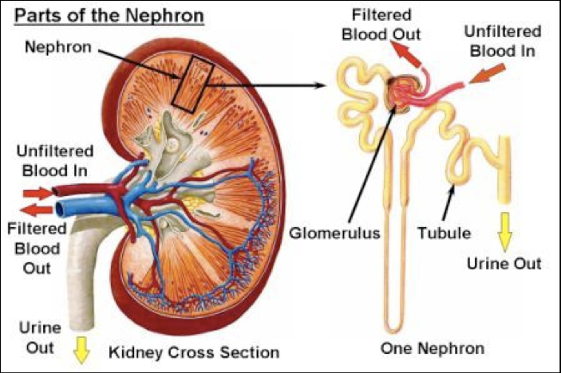
Nephrotic syndrome
- the symptom-complex developing due to a large proteinuria is also characterized by the expressed proteinuria, a hypoproteinemia, a lipidemia and the expressed edema

Slide 7
Acute Chronic
Nephrotic syndrome
Causes of nephrotic syndrome
- Acute infectious-toxic diseases (typhus, malaria, flu, etc.)
- Nephrotoxic poisons
- Transfusion of the incompatible blood
- Large burns
- Chronic glomerulonephritis
- Malaria
- Sepsis
- Tuberculosis
- DDCT
- Diabetes mellitus
- Amyloidosis

Slide 8
High proteinuria
(> 3,5 g/day, in children> 0,05 g/kg per day)
Nephrotic syndrome
Pathogenesis of nephrotic syndrome
Hypoproteinemia
Decrease in onkotic
blood pressure
Renal edema
Anasarca
Oliguria (because of the compensatory sodium retention)
Protein loss (= loss of enzymes
participating in the lipid
metabolism)
Compensation increase of
synthesis of LDLP, also develops
hypercholesterolemia
Atherosclerosis

Slide 9

Clinical manifestations of nephrotic syndrome - 1
Nephrotic syndrome
Complaints:
- common weakness
- appetite loss
- dryness in a mouth
- oliguria
- headache
- feeling of weight in a waist

Slide 10
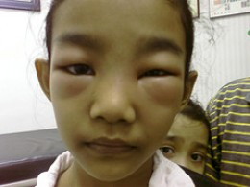
Clinical manifestations of nephrotic syndrome - 2
Nephrotic syndrome
General examination:
- renal edema, anasarca
- skin is pale, cold
- person (face) bloated

Slide 11
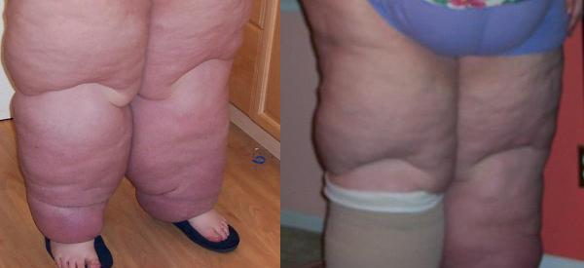
Kidney edema (anasarka)
Nephrotic syndrome

Slide 12
Laboratory manifestations in nephrotic syndrome
Nephrotic syndrome
- Proteinuria due to albumin decrease (>3,5 g/day; at children: > 0,05 g/kg per day)
- Hyperstenuria (density of urine = 1030 - 1040)
- Oliguria of 250 - 400 ml of urine per day
- Cylindruria (hyaline, granular, wax-like)
- Cholesterol crystals in urine
- Hypoproteinemia (hypoalbuminemia)
- Hyperlipidemiya (cholesterol in a blood plasma >13-15 mm/l)

Slide 13
Nephritic syndrome
- the symptom-complex which is characterized by existence of a hematuria, proteinuria, blood pressure, edema, oliguria and disturbance of excretory function of kidneys

Slide 14
Causes in nephritic syndrome
Nephritic syndrome
Glomerulonephritis
Systemic diseases:
Lupus erythematosus
Polyarteritis
Infectious endocarditis
Hemorrhagic vasculitis)

Slide 15
Clinical manifestations of nephritic syndrome
Nephritic syndrome
- A dull ache in kidneys
- Oliguria
- Urine of color of "meat slops"
- Renal edema (are expressed poorly, only on a face)
- Arterial hypertension
- Hypertrophy of a left ventricle

Slide 16
Laboratory tests data in nephritic syndrome
Nephritic syndrome
Blood analysis
- Urea increase
- Increase of a creatinine
- Decrease in clearance of a creatinine
- Anemia
Urine research
- Hematuria
- Cylindruria (erythrocyte)
- Proteinuria (<3 g/days)

Slide 17
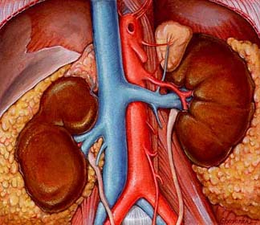
Chronic renal failure (CRF)
CRF - a symptom-complex,
caused by progressing nephrosclerosis.
Latent period of CRF
– disturbance of work of kidneys clinically are not shown and found only by express laboratory methods.
Evident period of CRF
– declares as uremia.

Slide 18
Chronic renal failure
Latent period of CRF
- Isohyposthenuria (density of urine of urine < 1017)
- Disturbances of reabsorption renal canaliculus
- Disturbances of filtration in glomerulus

Slide 19
Chronic renal failure
Evident period of CRF
Laboratory signs:
- Expressed isohyposthenuria (density of urine = 1009-1011)
- Hypernitrogenemia
- Increase in the content of urea, creatinine, indican

Slide 20
Chronic renal failure
Evident period of CRF
Clinical signs:
Nocturia
Izuriya
Foettor uremicus (remaining nitrogen in blood >70 mm/l)
Affection of mucosas of gastrointestinal tract:
- necrosis, ulcers of mucous mouth (stomatogingivitis)
- nausea, vomiting (uremic gastritis)
- diarrhea (uremic colitis)

Slide 21
Chronic renal failure
Evident period of CRF (2)
Clinical signs:
Affection of mucosa of respiratory tracts
- signes of uremic laryngitis, tracheitis, bronchitis
Affection of skin
- Complaints: on a painful skin itch
- At survey: having combed traces, urea crystals in the form of dust of pale yellow color
Affection of serous membranes
- Auscultation of heart: pericardial rub (in uremic pericarditis)

Slide 22
Chronic renal failure
Evident period of CRF (3)
Clinical signs:
Symptoms of common intoxication
- Disorder of memory and dream, increased fatigue, dull headache, develops drowsiness and apathy
Vision disorders
- At research of an eye fundus: narrowing of arteries, a phlebectasia, a papilledema, hazy foci on retina (neuroretinitis)
Metabolic disorders
- At survey: cachexia

Slide 23
Chronic renal failure
Evident period of CRF (4)
Clinical signs:
Hematopoiesis affection
Uremic anemia
Leukocytosis
Thrombocytopenia
Hemorrhagic syndrome

Slide 24
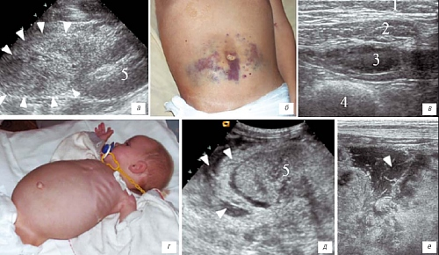
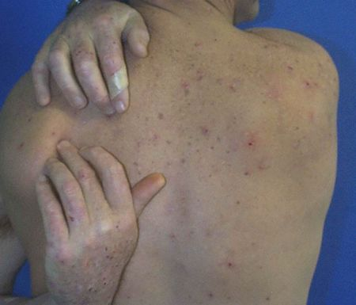
Chronic renal failure

Slide 25
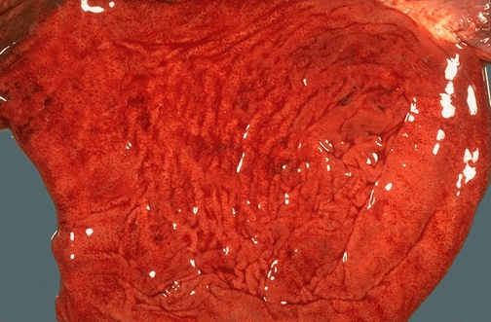
Stomach hyperemia at CRF
Chronic renal failure

Slide 26
Chronic renal failure
Uremic coma
- The periods of retardation alternate with the exaltation periods and hallucinations
- Kussmaul's respiration (noisy, deep, infrequent),
sometimes Cheyn-Stokes's respiration (variable increase and weakening of respiration)
- Deep coma
- Muscle twitchings
- Lethal outcome

Slide 27
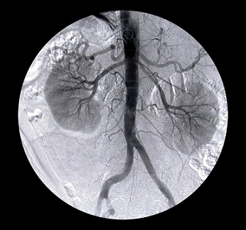
Thank you for attention!

